Slide 1


FIT9136 PASS WEEK 5
Introduction to Data Structure & Collective Data Types
19th Aug 2024
CL_33 Innovation Walk, Room C107 / Online

Slide 2
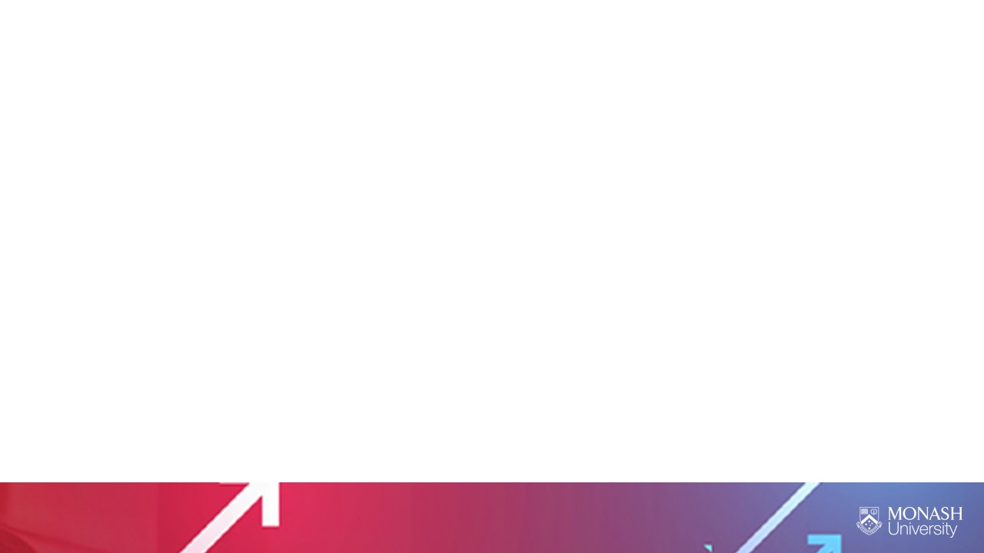
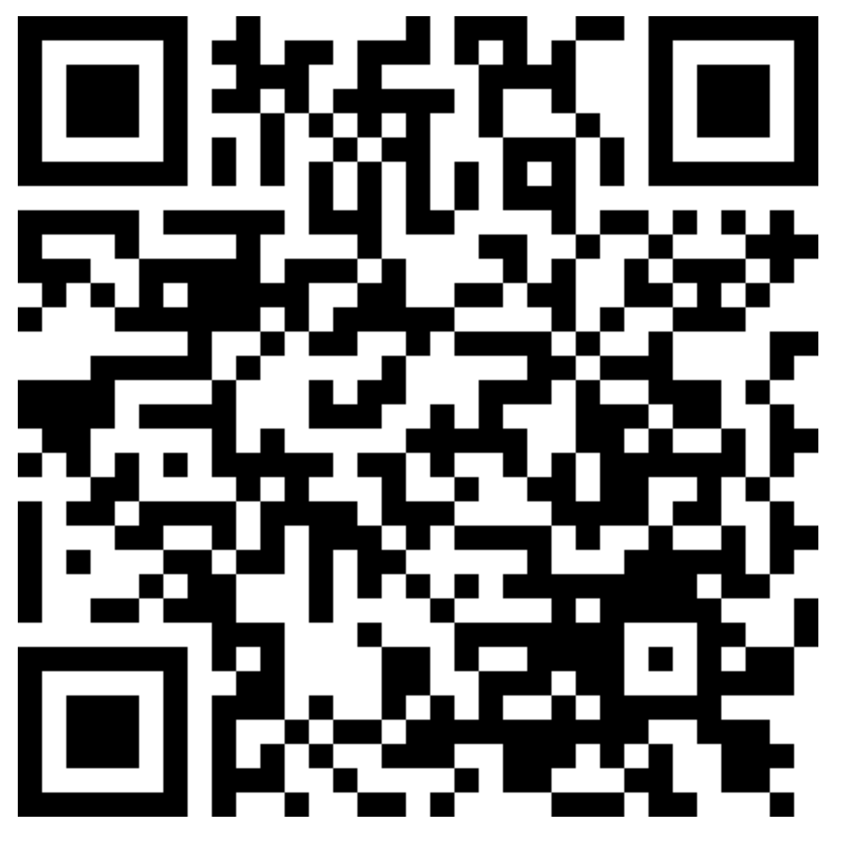
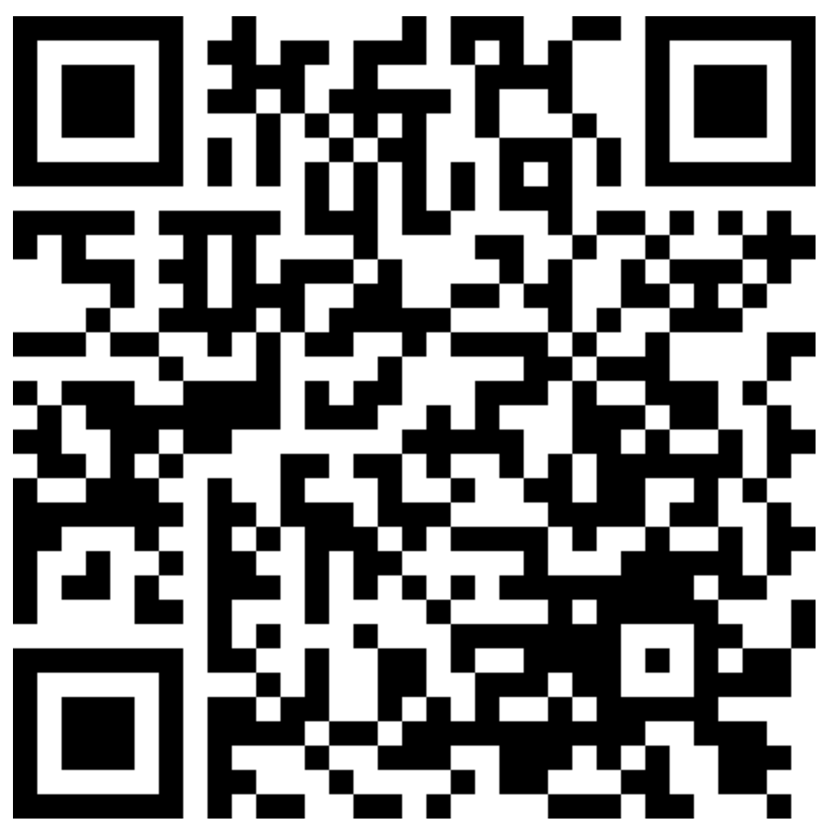
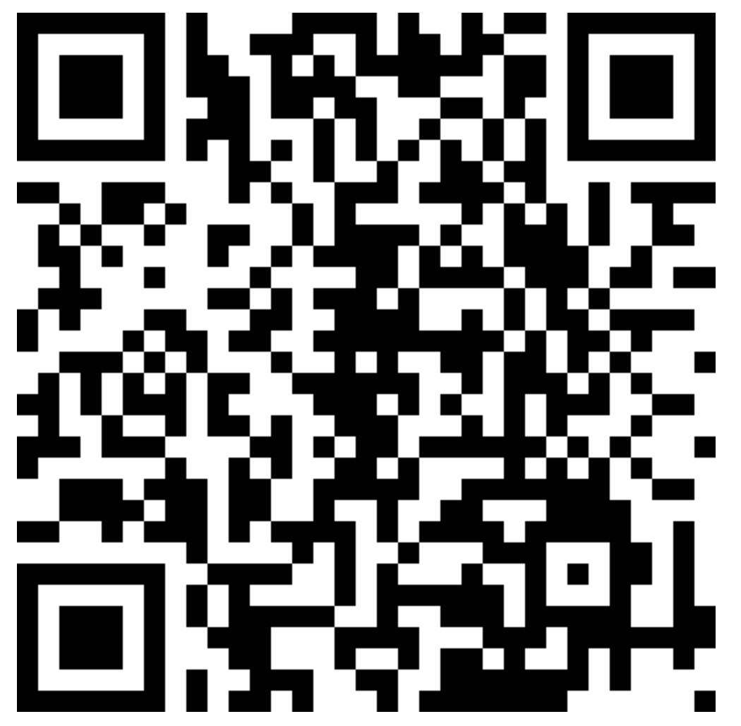

Attendance & Resources
Attending sessions is not mandatory but highly recommended.
Attendance is not assessed.
Any questions? Email me: harry.wang1@monash.edu
Also find the drive to receive the weekly slides: https://tinyurl.com/FIT9136-PASS
Monday 2-3pm
Tuesday 9-10am
Tuesday 4-5pm

Slide 3
Agenda
01
Set - 15 mins
Please input your questions for each practice into the form below:
https://tinyurl.com/PASS-Wk5-questions
Concept recap + practice + solution
02
Dictionary - 30 mins
Concept recap + practice + solution
03
Closure speaking - 10 mins
Attendance recording

Slide 4
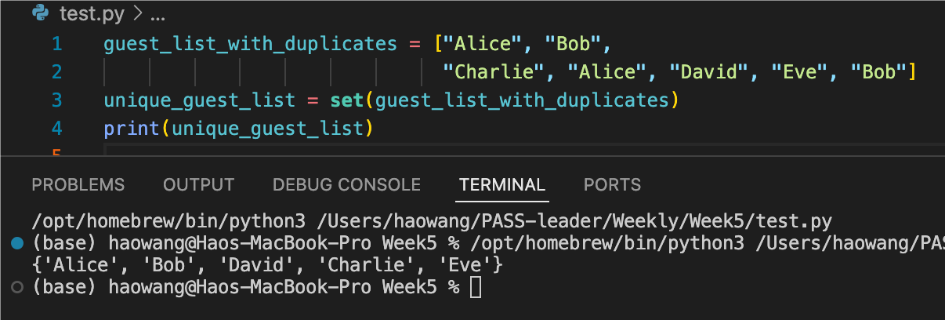
Question form: https://tinyurl.com/PASS-Wk5-questions
Revision 1 - Set
1. Unique Elements: All elements in a set are unique, meaning no duplicates are allowed.
2. Unordered: Sets do not maintain the order of elements, so the items may appear in any order.
3. Mutable: You can modify a set by adding or removing elements after it has been created.

Slide 5
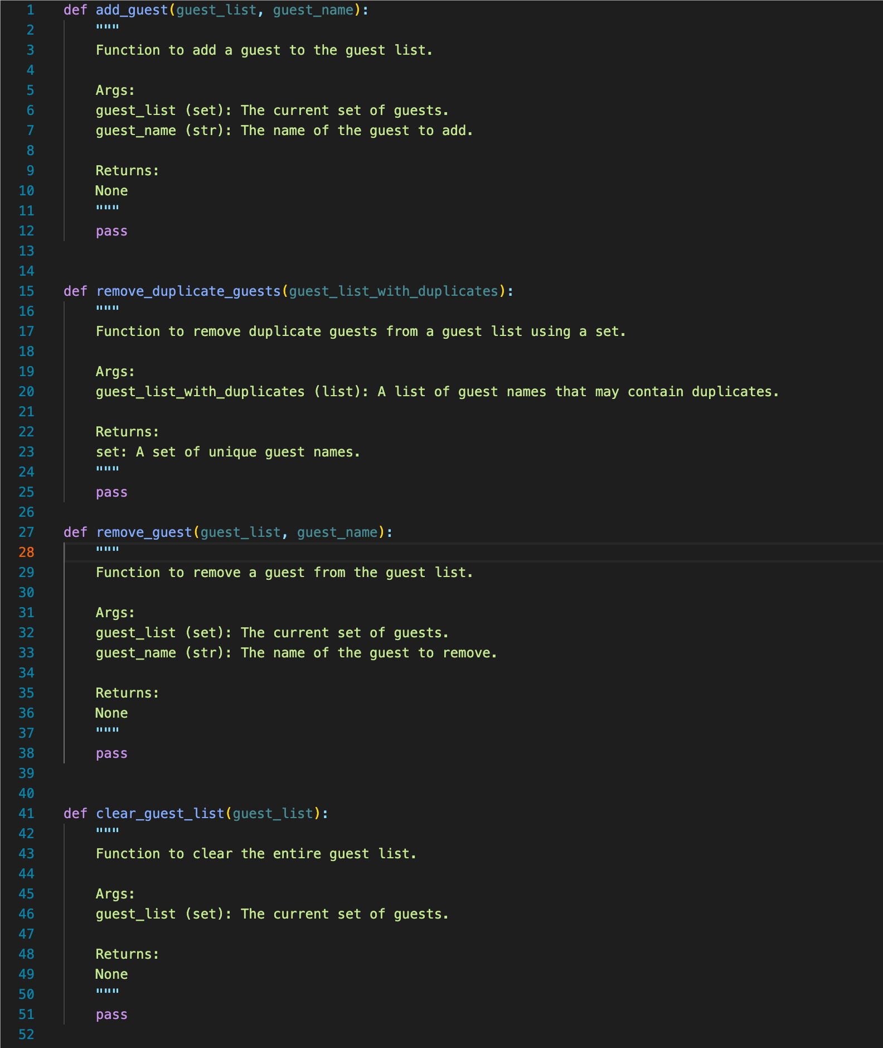
Question form: https://tinyurl.com/PASS-Wk5-questions
Revision 1 - Problem
You are organizing an exclusive event, and you need to manage the guest list. Guests may be added or removed from the guest list, and sometimes you may need to clear the list entirely. Additionally, you need to ensure that the guest list does not contain any duplicates. Your task is to manage the guest list using Python sets, emphasizing the uniqueness of elements in the set.
Task:
Create a Python program that performs the following operations using sets:
1. Add Guests: Use the add() method to add guests to the guest list. Ensure that each guest appears only once in the list.
2. Remove Duplicate Guests: Start with a guest list that contains duplicates and use a set to remove any duplicate guests.
3. Remove Guests: Use the remove() method to remove specific guests from the guest list.
4. Clear the Guest List: Use the clear() method to remove all guests from the list.
Base code: https://tinyurl.com/FIT9136-PASS /Week5/practise_questions/set_queston.py

Slide 6
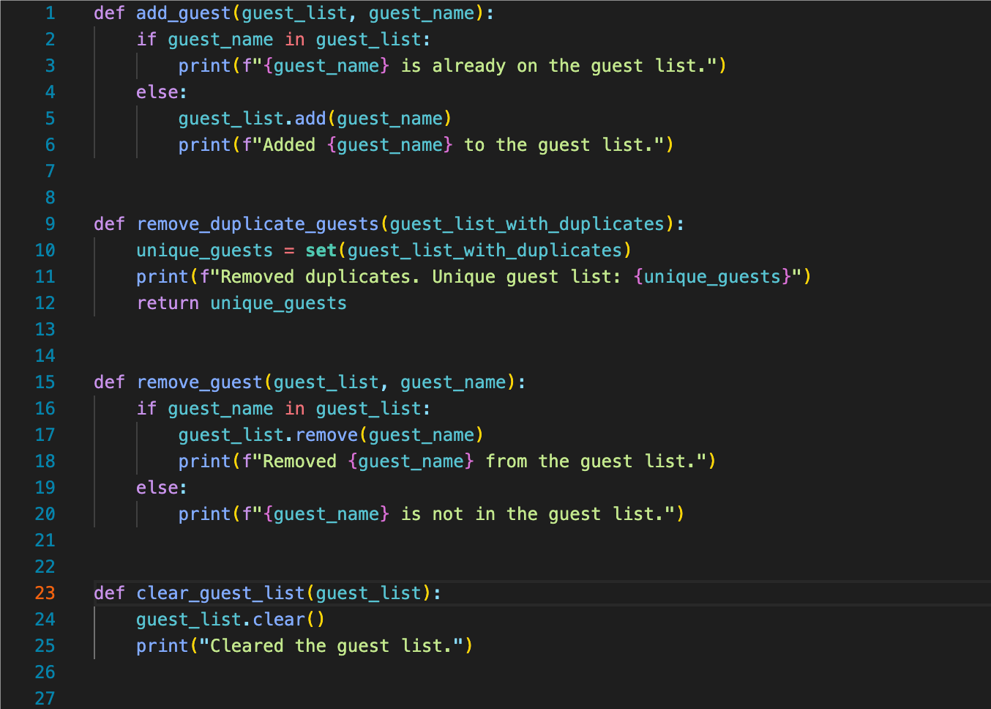
Question form: https://tinyurl.com/PASS-Wk5-questions
Revision 1 - Solution
.add()
set()
.remove()
.clear()

Slide 7
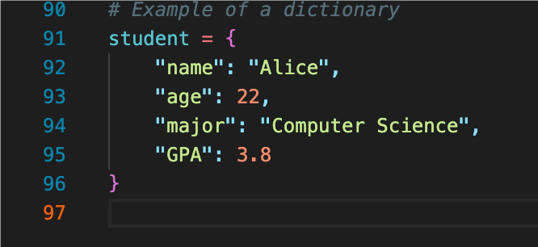
Question form: https://tinyurl.com/PASS-Wk5-questions
Revision 2 - Dictionary
Keys: Keys are unique identifiers in the dictionary.
Values: Values are the data associated with each key.
Fast Lookup: Dictionaries allow you to quickly access data by using keys instead of searching through a list.
Organized Data: Dictionaries help you organize data in a structured way.
Uniqueness: The keys in a dictionary must be unique.

Slide 8
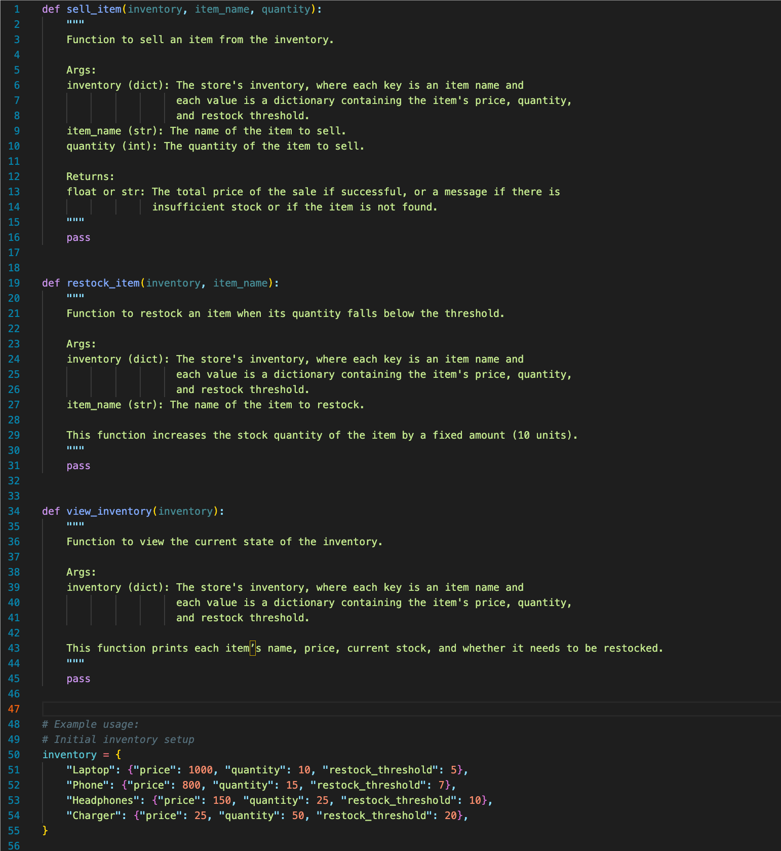
Question form: https://tinyurl.com/PASS-Wk5-questions
Revision 2 - problem
You are tasked with creating an inventory management system for a small electronics store. The store sells various items like laptops, phones, and accessories. The store needs a system to keep track of inventory levels, manage sales, and restock items when needed.
Task:
1. Store Inventory: Use a dictionary to represent the inventory of items in the store. The keys of the dictionary should be the item names, and the values should be another dictionary containing the price, stock quantity, and a restock threshold.
2. Sell Items: Implement a function that allows the store to sell an item. The function should update the stock quantity, calculate the total sale price, and check if the item needs to be restocked.
3. Restock Items: Implement a function that automatically restocks items when the stock quantity falls below the restock threshold (10 units).
4. View Inventory: Implement a function that prints the current inventory in a readable format, showing each item’s name, price, stock quantity, and whether it needs to be restocked.
Base code: https://tinyurl.com/FIT9136-PASS /Week5/practise_questions/dictionary_queston.py

Slide 9
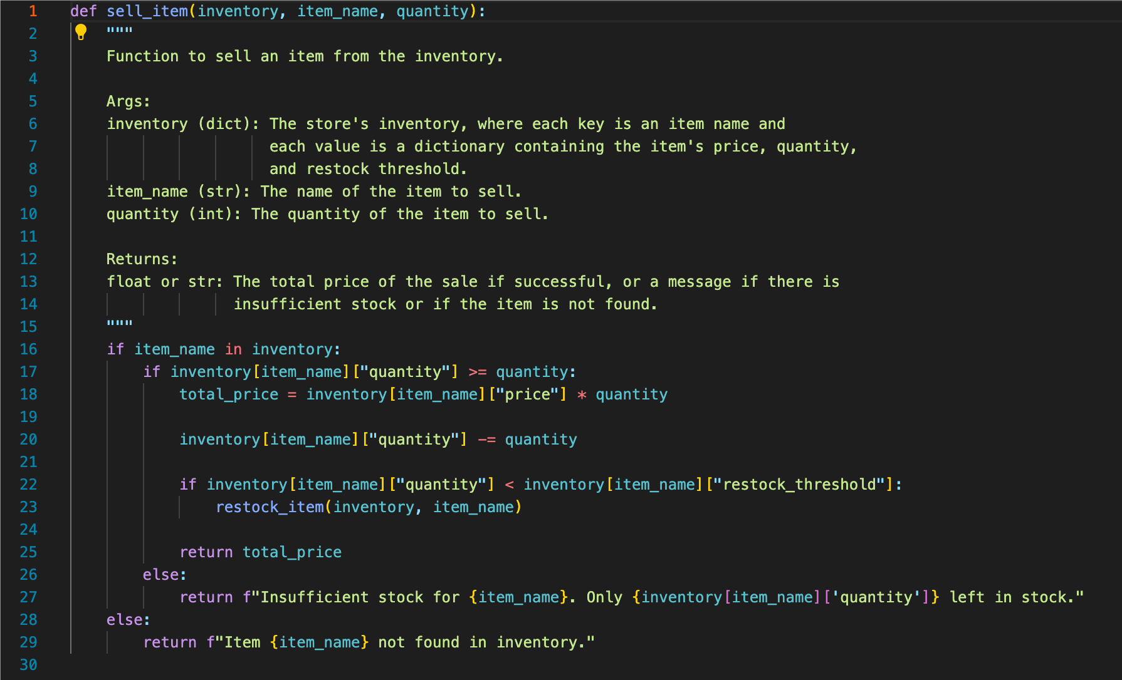
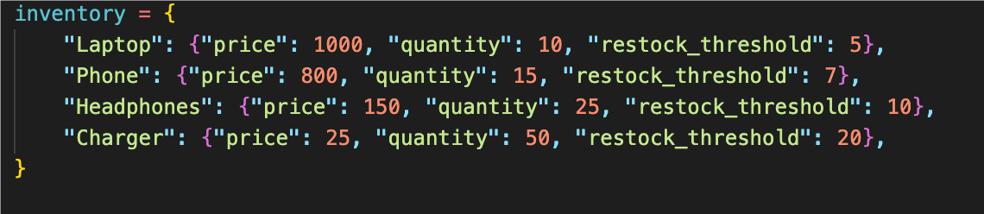
Question form: https://tinyurl.com/PASS-Wk5-questions
Revision 2 - Solution (Item selling)
You are tasked with creating an inventory management system for a small electronics store. The store sells various items like laptops, phones, and accessories. The store needs a system to keep track of inventory levels, manage sales, and restock items when needed.
Sell Items: Implement a function that allows the store to sell an item. The function should update the stock quantity, calculate the total sale price, and check if the item needs to be restocked.

Slide 10
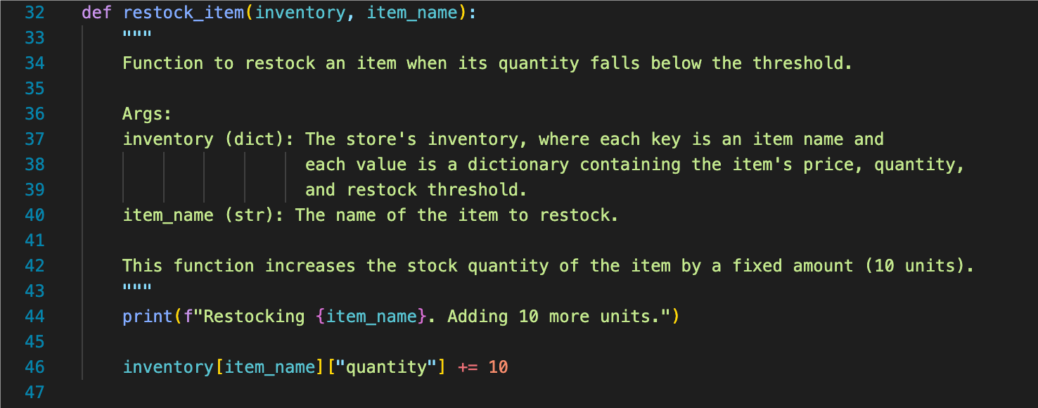
Question form: https://tinyurl.com/PASS-Wk5-questions
Revision 2 - Solution (Restocking)
You are tasked with creating an inventory management system for a small electronics store. The store sells various items like laptops, phones, and accessories. The store needs a system to keep track of inventory levels, manage sales, and restock items when needed.
Restock Items: Implement a function that automatically restocks items when the stock quantity falls below the restock threshold (10 units).

Slide 11
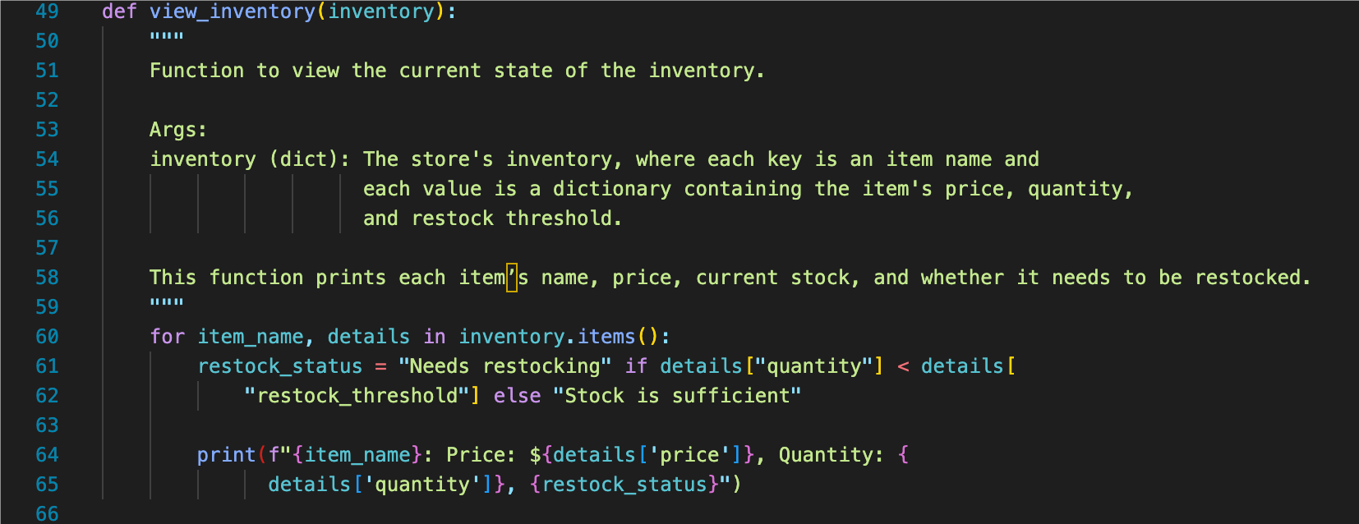
Question form: https://tinyurl.com/PASS-Wk5-questions
Revision 2 - Solution (Traversal the dictionary)
You are tasked with creating an inventory management system for a small electronics store. The store sells various items like laptops, phones, and accessories. The store needs a system to keep track of inventory levels, manage sales, and restock items when needed.
View Inventory: Implement a function that prints the current inventory in a readable format, showing each item’s name, price, stock quantity, and whether it needs to be restocked.

Slide 12
Conclusion
Set: add(), remove(), clear(), set()
Dictionary: indexing, traversal the whole dictionary

Slide 13
Attendance & Resources
Attending sessions is not mandatory but highly recommended.
Attendance is not assessed.
Any questions? Email me: harry.wang1@monash.edu
Also find the drive to receive the weekly slides: https://tinyurl.com/FIT9136-PASS
Monday 2-3pm
Tuesday 9-10am
Tuesday 4-5pm

Slide 14
Thank You
19th Aug 2024
CL_33 Innovation Walk, Room C107 / Online

Slide 15
Questions & Answers
19th Aug 2024
CL_33 Innovation Walk, Room C107 / Online

